Slide 1
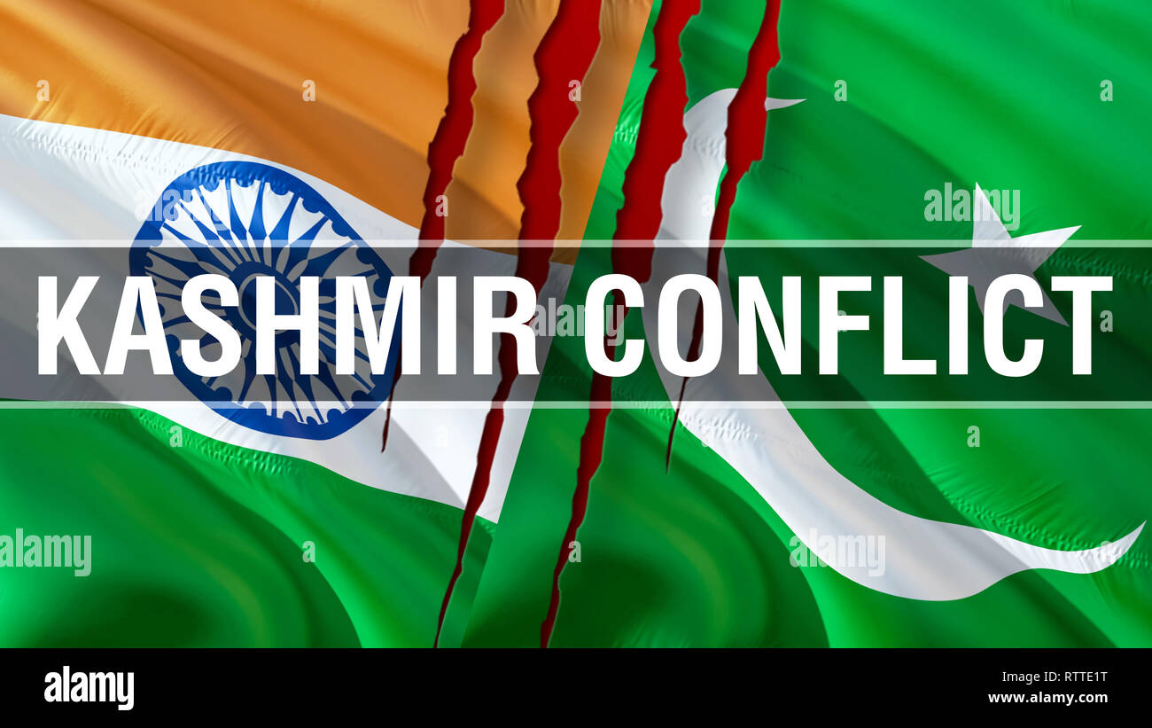
Aamir Hashmi (2023-CS-11)

Slide 2
INTRODUCTION
The Kashmir Conflict is a territorial conflict between India and Pakistan over the Kashmir region.
The conflict started after the partition of India in 1947 over the region of Jammu and Kashmir.
Escalated into three wars between India and Pakistan.
China has also been involved in the conflict in a third party role.

Slide 3
HISTORICAL BACKGROUND
The history of Kashmir is attached with the history of broader Indian subcontinent and the surrounding regions, comprising the areas of Central Asia, East Asia and South Asia.
The Kashmir region became an important centre of Hinduism and later of Buddhism.
Islam in Kashmir took place from 13th to 15th century.

Slide 4
GEOGRAPHICAL IMPORTANCE
The Kashmir region has a total area of about 86,772 square miles, of which:
India controls the land at 39,127 square miles.
Pakistan controls 33,145 square miles.
China controls an area of 14,500 square miles.
Kashmir has a varied climate.
Kashmir‘s economy is mostly made up of agriculture that takes place in its fertile valley areas.

Slide 5
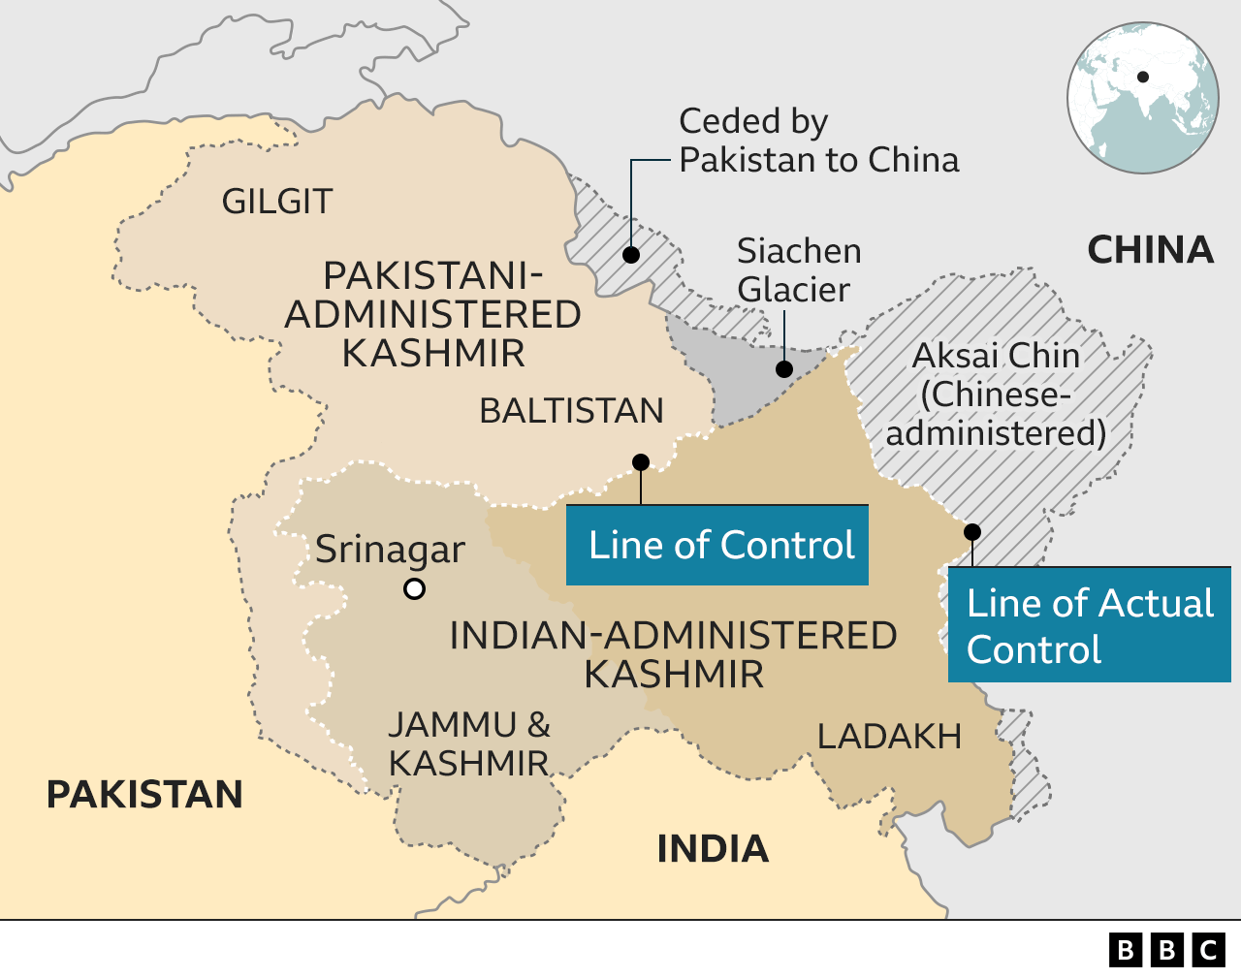

Slide 6
REASONS BEHIND DISPUTE
Both India and Pakistan subsequently maid claims to Kashmir, based on the history and religious affiliations of Kashmiri people.
Movements by India and Pakistan took place leading to a war , as a result of which the state of Jammu and Kashmir remains divided between India and Pakistan.

Slide 7
HUMAN RIGTH ABUSES
Human rights abuses such as extra judicial killings and rapes have been committed by Indian forces in Kashmir.
Several international agencies and UN have reported violation of human rights in Indian Administered Kashmir.

Slide 8
ROLE OF UNITED NATIONS
During the 1948 Indo-Pak tension, the UN Security Council passed a resolution and created United Nation Commission on India & Pakistan (UNCIP).
UN had suggested referendum in Kashmir to resolve Kashmir Conflict.
But India continued showing bad intentions because India knows that more than 80% population of Kashmir is Muslim and referendum will be in favour of Pakistan.

Slide 9
We still have hopes that Inshallah Kashmir conflict will be resolved one day and Kashmir will be free one day.
THANK YOU

